Slide 1
User assistance using Computational perception and deep learning
Kundan Kumar
Arvind Ranganathan

Slide 2
Our aim is to provide automated user assistance using openCV and deep learning.
User gesture recognition using deep learning already exists, and we want to use this to build a simple solution aimed at a practical application.

Slide 3
Our Approach
Step 1
Step 2
Step 3
Detection
Application is programmed to detect hand gestures and perform configured actions.
uses Laptop camera
Training
Several hand gesture images are recorded and the hand gesture is detected by the application, both are fed into the learning module
Run
Both detection and learning modules detect hand gestures of any random image and perform configured actions.

Slide 4
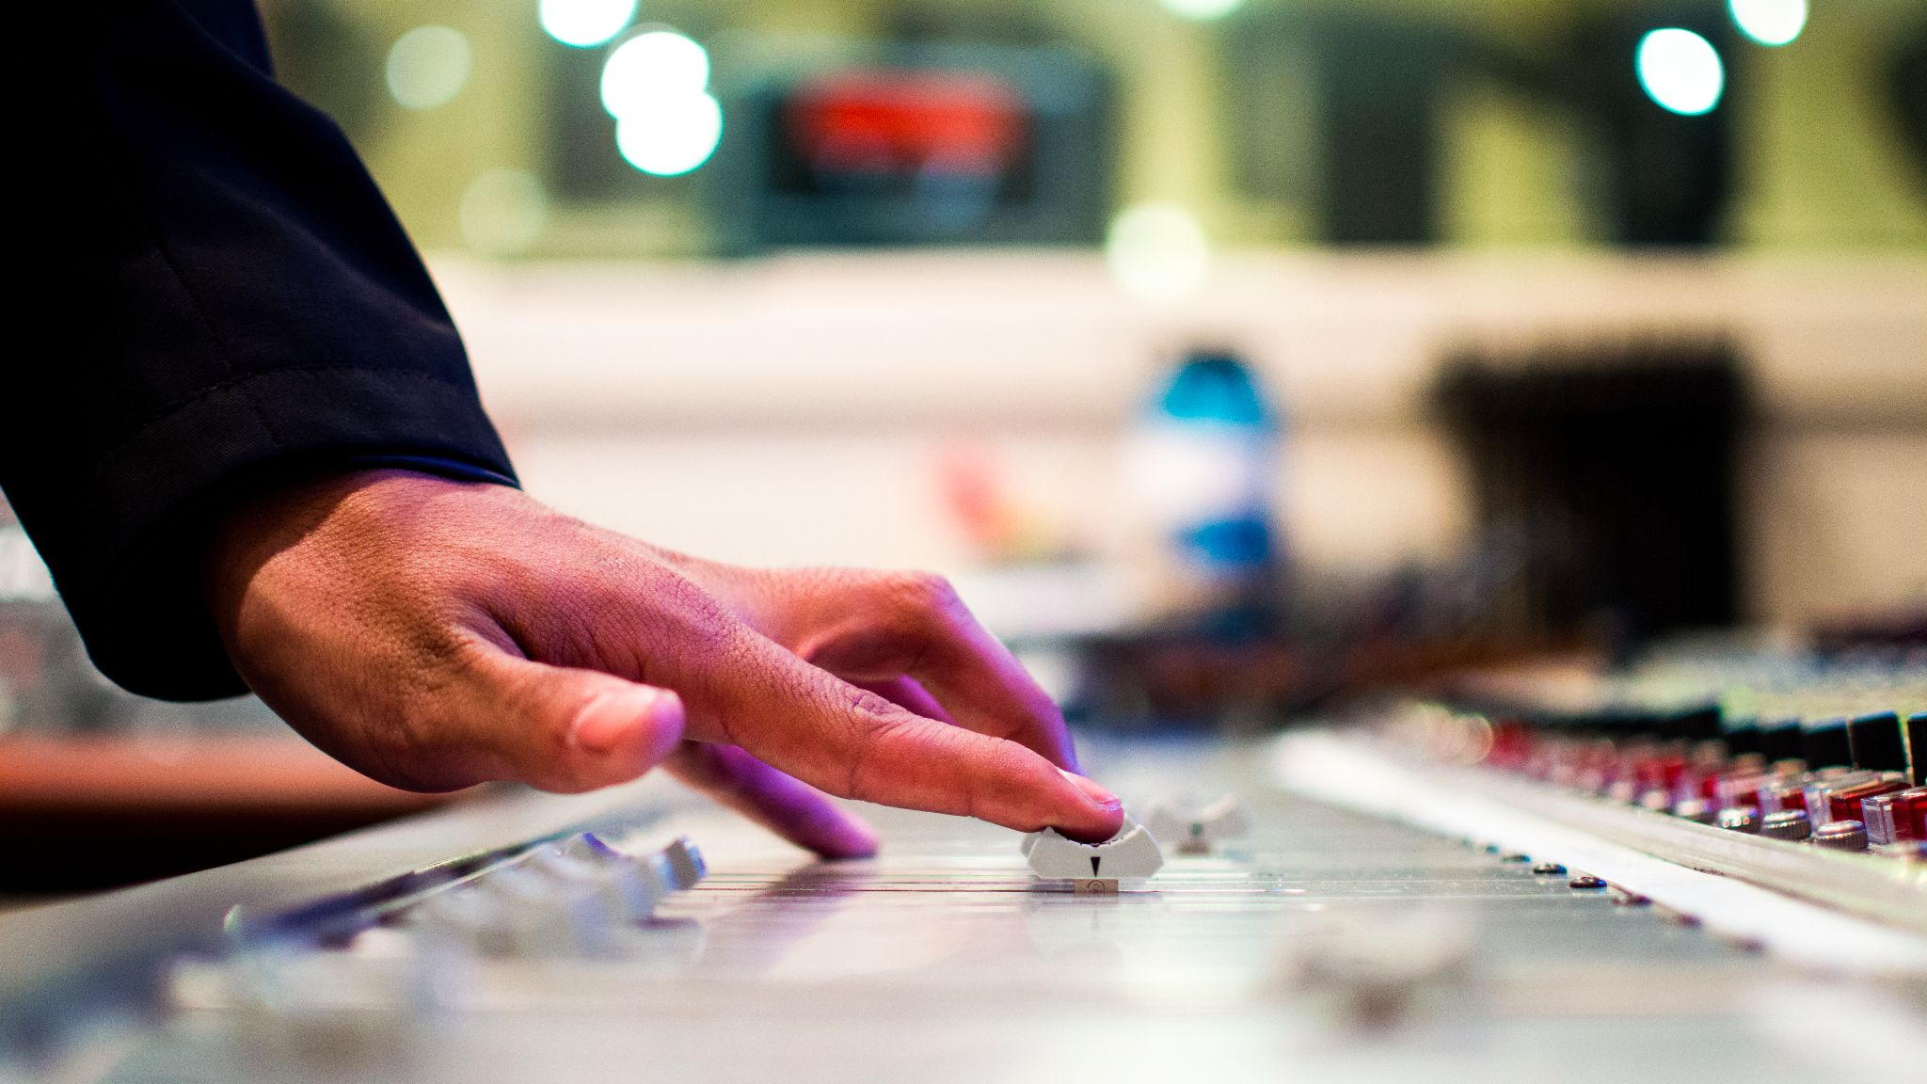
The Technology
OpenCV + Deep Learning

Slide 5
Module Architecture
Detection module
Learning module
Integrated-action module
Detects the hand gesture in the image captured by the camera
we will use the camera in our laptop
built using Python and OpenCV
Analysis both the camera image and the detected gesture and builds its model, and returns the analyzed gesture for any random image
uses convoluted neural networks
It sends the image from the camera to the learning module and performs the action based on the result returned

Slide 6
Data flow
Detector module
detect hand gesture in captured image
Integration module
Sends the captured image to the fully trained learning module, forwards the value to the action module
Learning module
analysis the captured image and gesture and builds internal model
Action module
action mapped for the gesture is performed

Slide 7
Evaluation methodology
Step 1
Step 2
Step 3
Detection evaluation
Successful detection of three simple gestures for a selected hand.
open palm
Two fingers
Training
Successful detection of the three gestures for any random hand image
Run
System will detect the gestures any live hand image shown to it, and perform the action
future work will involve more hand gestures

Slide 8
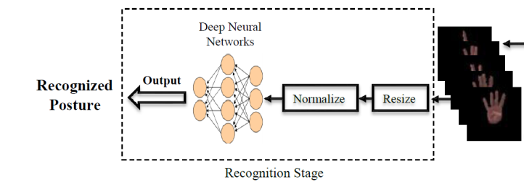
Architecture

Slide 9
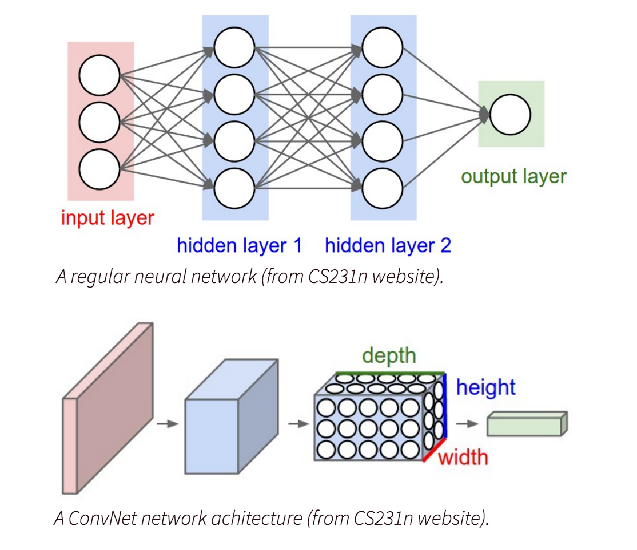
Neural network

Slide 10
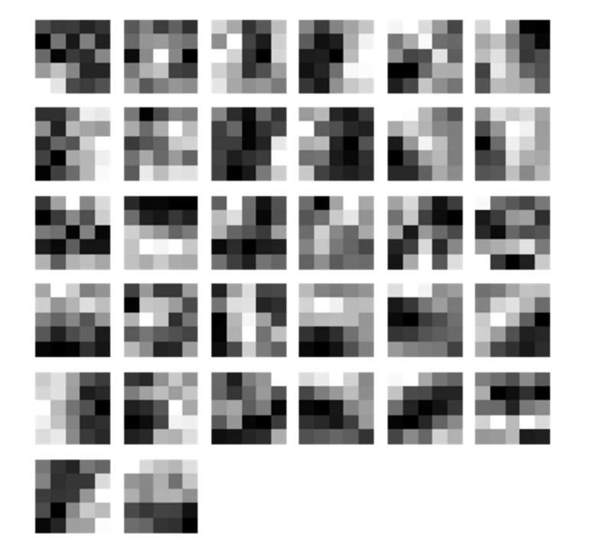
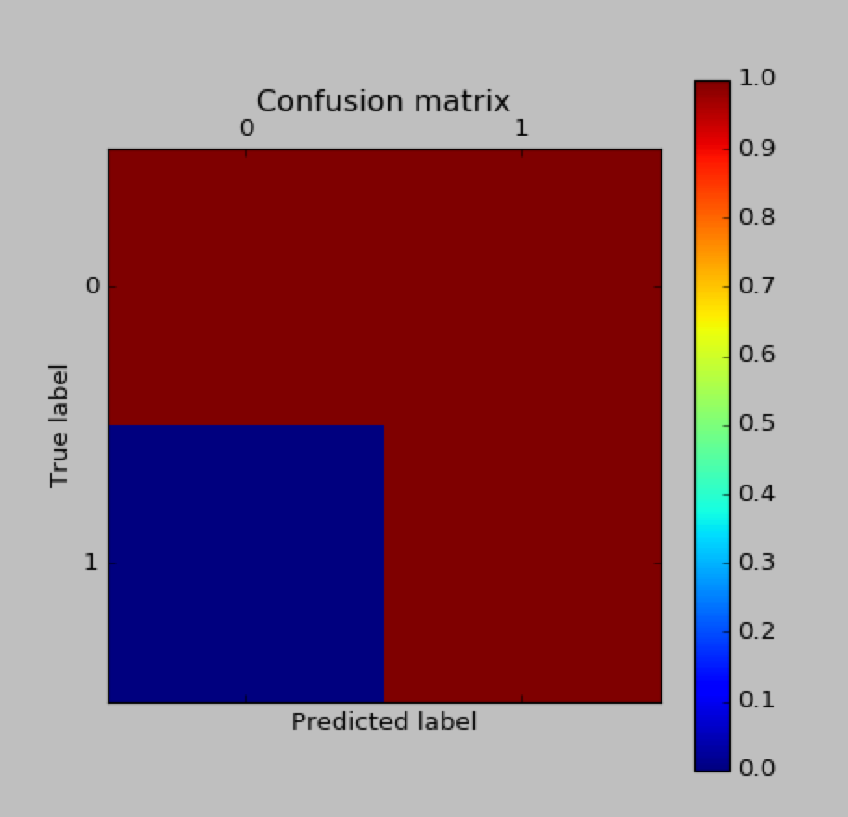
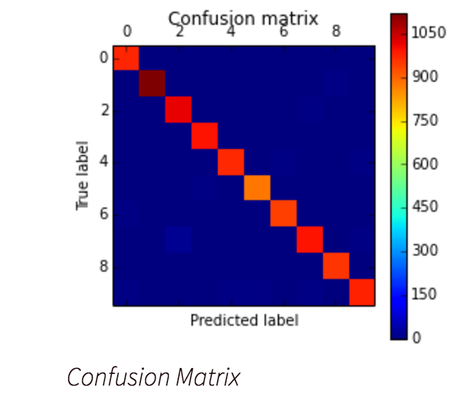
Experimental results

Slide 11
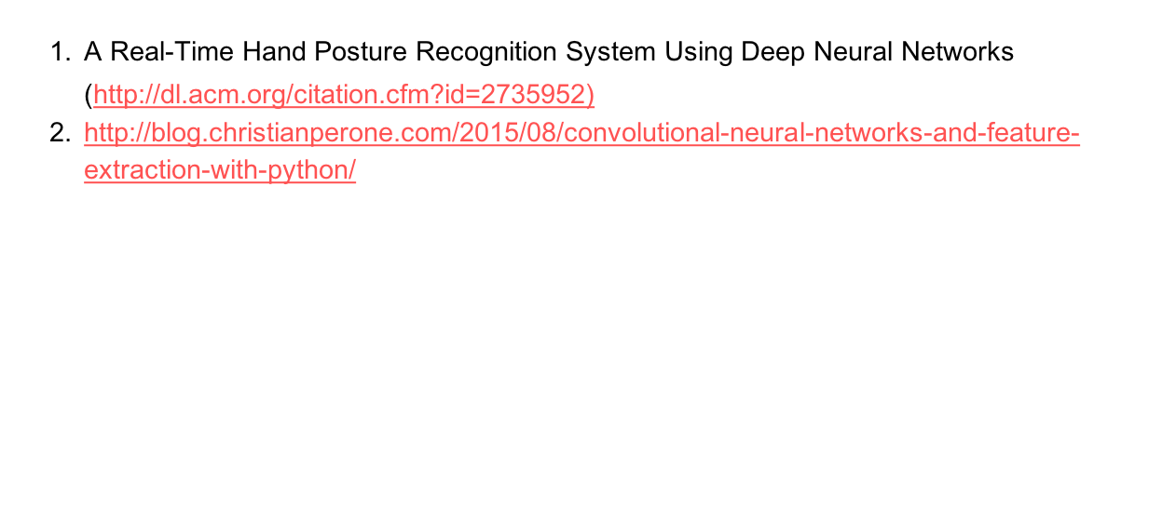
References

